Slide 1
Review of Intro to Film
What everyone needs to know…

Slide 2
Cinematography
Camera Angles:
Eye Level
High Angle
Low Angle
Dutch Angle
Bird’s Eye View
Worm’s Eye View

Slide 3
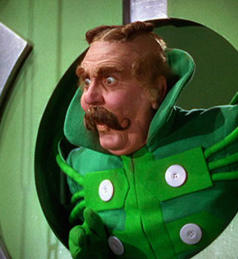
Eye Level

Slide 4
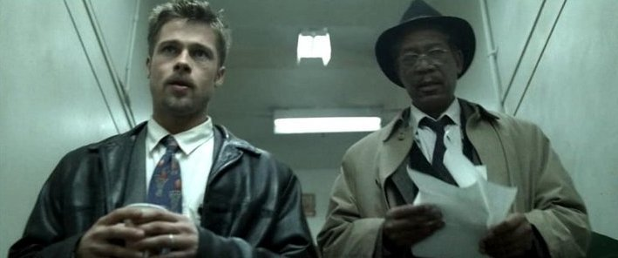
Low Angle

Slide 5
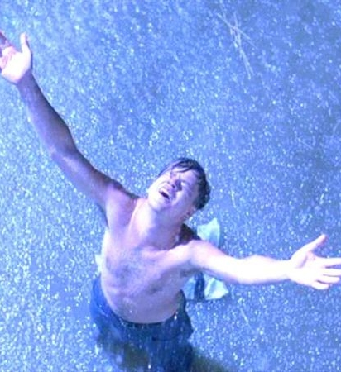
High Angle

Slide 6

Dutch Angle

Slide 7
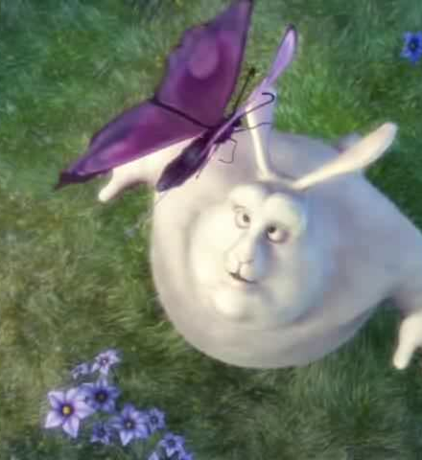
Bird’s Eye View

Slide 8
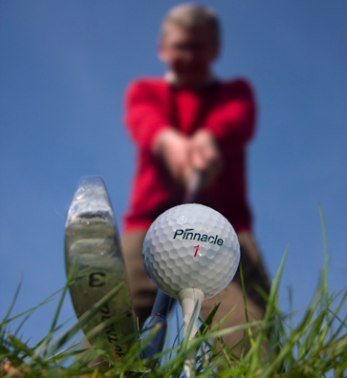
Worm’s Eye View

Slide 9
Camera Shots
Extreme Close Up
Close Up
Medium Close Up
Medium Shot
Medium Wide Shot
Wide Shot
Extreme Wide Shot
Full Shot
Object of Interest Shot

Slide 10
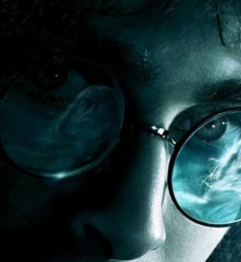
Extreme Close Up

Slide 11
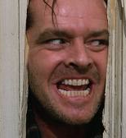
Close Up

Slide 12

Medium Close Up

Slide 13

Medium Shot

Slide 14
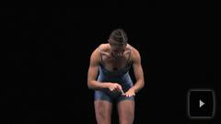
Medium Wide Shot

Slide 15
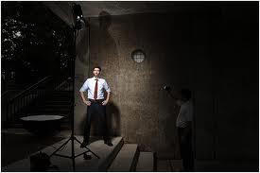
Wide Shot

Slide 16
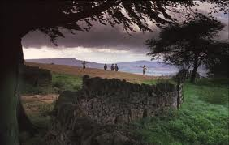
Extreme Wide Shot

Slide 17

Full Shot

Slide 18
Other Concepts
Rule of Thirds

Slide 19

Rule of Thirds

Slide 20
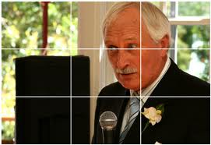
Rule of Thirds

Slide 21

Rule of Thirds

Slide 22
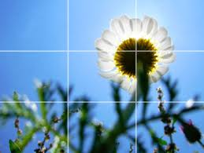
Rule of Thirds

Slide 23
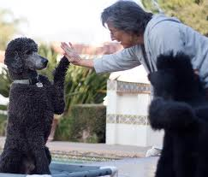
Rule of Thirds

Slide 24
Camera Movement
Pan Shot
Tilt Shot
Dolly Shot
Zoom Shot
Crane Shot
Handheld
Steadicam

Slide 25
Pan Shot
- Horizontal movement of the camera on its stationary tripod.
- Follows people walking, moving, etc…

Slide 26
Tilt Shot
Vertical movement of camera mounted on a stationary tripod.
- Simple movement but creates dynamic meaning.

Slide 27
Dolly Shot
Also known as tracking shot
Shot taken by a camera that is fixed to a wheeled support.
Forwards and backwards towards a subject.

Slide 28
Truck Shot
- Camera movement moves beside camera action, left to right.

Slide 29
Zoom Shot
Zoom is both a lens and a camera movement.
You get closer or further away on an object.
Magnifies the image.

Slide 30
Crane Shot
Camera is mounted on an elevating arm, and mounted on a vehicle.
Smooth movement, low and high angle shots.

Slide 31
Handheld Camera
Small, lightweight camera held by camera operator during shooting.
Inherent shakiness exploited for artistic sake

Slide 32
SteadiCam
A device attached to the camera man, that steadies the camera shot while moving.
Simulates walking.
Glidecam is cheaper version. We have it!! ☺

Slide 33
Poster or Tissue Box Project
Must take pictures of either angles or shots and glue to your tissue box or poster. You can either print them from computer or at Walgreens, etc..
Must be ORIGINAL pictures.
Due Next Week

